Slide 1


Categorizing Sentiments of Pandemic Tweets Using
NLP
Group: 15
Group Members:
Md Tawhidur Rahman
Abrar Ahmed
Nusaiba Alam
Tahiya Mysara Yusha

Slide 2
Introduction
The coronavirus pandemic drastically changed daily life, pushing people to adapt and share their thoughts on platforms like Twitter. Our research aims to build a model using natural language processing (NLP) techniques to analyze the sentiment of pandemic-related tweets.
We cleaned the dataset through preprocessing. Using TensorFlow and Keras, we developed a deep learning model with layers for word processing, sequential input, and classification.
The goal is to classify tweets into five sentiment categories—positive, neutral, negative, highly positive, and extremely negative—to help understand public opinion during the pandemic.

Slide 3
Preprocessing Steps
Cleaned the tweets:
Removed extra whitespace.
Removed URLs.
Removed stop words.
Lemmatize (requires POS tagging)
Kept specific punctuation and alphanumeric characters.
Reduced repetitions of marks to single occurrences.
Applied one-hot encoding to the 'Sentiment' column:
Negative
Extremely negative
Positive
Extremely positive
Neutral
1
2

Slide 4
Preprocessing Steps
Kept only the necessary columns and dropped others
3
4
Train-Test-Validate split where train 80% test 10% validate 10%
5
Fit the tokenizer on the training data
Applied padding to the tokenized data
6
7
Training features Undersampling
8
Performed embeddings on the padded tweets

Slide 5
Preprocessing Steps
Cleaned
The
Tweets
One
Hot
Encoding
Keeping
only
The
Necessary
columns
Train
Test
Validate
Split
Embedding
Under
Sampling
Padding
Tokenizer
On
Training
Data

Slide 6
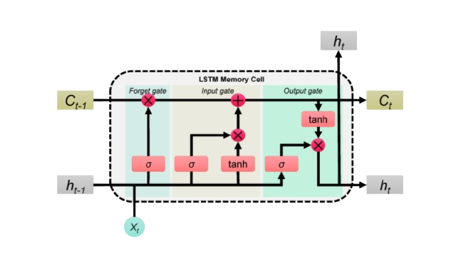
Models
LSTM

Slide 7
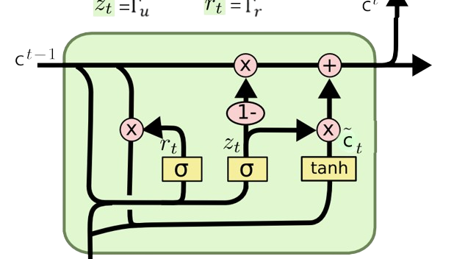
Models
GRU

Slide 8
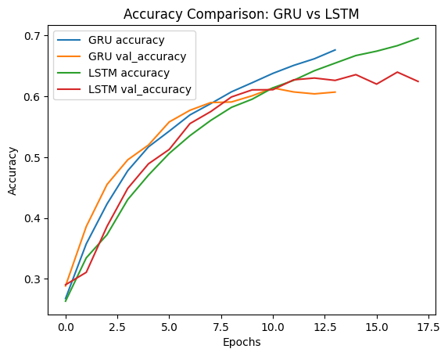
LSTM vs GRU

Slide 9
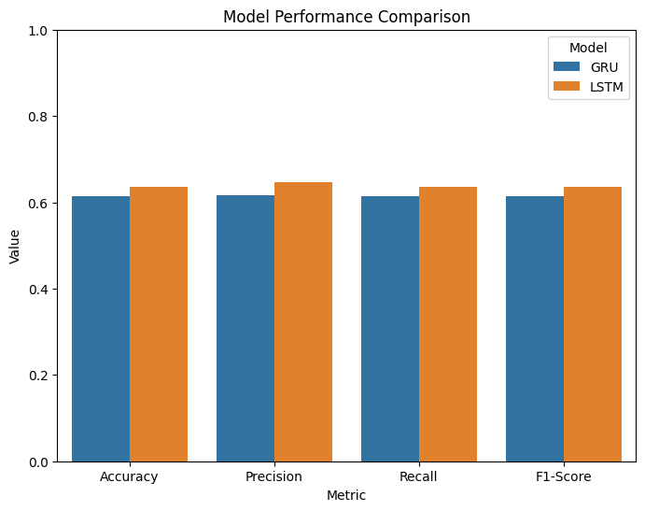
LSTM vs GRU

Slide 10
Conclusion
In the sentiment analysis project focused on pandemic tweets, various challenges were addressed. Effective data preprocessing included thorough text cleaning, tokenization, and padding for varying tweet lengths. Class imbalance was tackled using SMOTE for oversampling minority classes, ensuring fairness. The embedding matrix was constructed with pre-trained GloVe vectors, enhancing word representation. Models using LSTM and GRU architectures were optimized through hyperparameter tuning and early stopping to prevent overfitting. Comprehensive evaluation metrics were employed for accurate performance assessment, and emphasis was placed on data quality through careful curation and consistent labeling. These strategies led to a robust sentiment analysis model.

Slide 11

Thank you.

